Slide 1

Cloud Balancing Architecture
By,
Sarnali Sarkar (96/DTS NO.210011)
M.Sc Data Science 2nd Semester
Department of Computer Science & Engineering

Slide 2
CONTENTS
What is Cloud Balancing Architecture?
Advantages of Cross-Cloud Balancing.
Load Balancing.
Automated Scaling Listener.
Failover System Mechanism.
Cloud Balancing Process.
Use of Automated Scaling Listener & Failover System in cloud Balancing Architecture.
Conclusion.
Acknowlegment.
References.
M.Sc Data Science 2nd Semester
Department of Computer Science & Engineering(Data Science)

Slide 3
What is Cloud Balancing Architecture?
The cloud balancing architecture establishes a specialized architectural model in which IT resources can be load balanced across multiple clouds. Example:- AWS Architecture,Google Cloud,Google Cloud Run etc,.
M.Sc Data Science 2nd Semester
Department of Computer Science & Engineering(Data Science)

Slide 4
Load Balancing
Load balancing is a technique used to distribute workloads uniformly across servers or other compute resources.
Load balancing solutions can be categorized into two types: –
Software-based load balancers.
Hardware-based load balancer.
Major Examples of Load Balancers :–
Direct Routing Requesting Dispatching Technique.
Dispatcher-Based Load Balancing Cluster.
Linux Virtual Load Balancer.
M.Sc Data Science 2nd Semester
Department of Computer Science & Engineering(Data Science)

Slide 5
Advantages of Cross-Cloud Balancing
Improve the performance and scalability of IT resources.
Increase the availability and reliability of IT resources.
Improve load-balancing and IT resource optimization.
M.Sc Data Science 2nd Semester
Department of Computer Science & Engineering(Data Science)

Slide 6
Automated Scaling Listener
The automated scaling listener mechanism is a service agent that monitors and tracks
communications between cloud service consumers and cloud services for dynamic scaling
purposes. Automated scaling listeners are deployed within the cloud, typically near the
firewall, from where they automatically track workload status information. For a cloud balancing
architecture to function effectively, the automated scaling listener needs to be aware of all
redundant IT resource implementations within the scope of the cloud balanced architecture.
M.Sc Data Science 2nd Semester
Department of Computer Science & Engineering(Data Science)

Slide 7
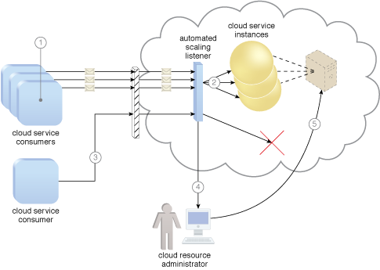
Automated Scaling Listener
M.Sc Data Science 2nd Semester
Department of Computer Science & Engineering(Data Science)

Slide 8
Failover System Mechanism
The failover system mechanism is used to increase the reliability and availability of IT resources by using established clustering technology to provide redundant implementations. A failover system is configured to automatically switch over to a redundant or standby IT resource instance whenever the currently active IT resource becomes unavailable.
Failover systems come in two basic
configurations:
Active-Active
Active-Passive
M.Sc Data Science 2nd Semester
Department of Computer Science & Engineering(Data Science)

Slide 9
Cloud Balancing Architecture Demo
M.Sc Data Science 2nd Semester
Department of Computer Science & Engineering(Data Science)

Slide 10
Use of Automated Scaling Listener & Failover System in cloud Balancing Architecture
The two mechanisms are utilized as follows:
The automated scaling listener redirects cloud service consumer requests to one of several redundant IT
resource implementations, based on current scaling and performance requirements.
The failover system ensures that redundant IT resources are capable of cross-cloud failover in the event
of a failure within an IT resource or its underlying hosting environment. IT resource failures are announced
so that the automated scaling listener can avoid inadvertently routing cloud service consumer requests to
unavailable or unstable IT resources.
M.Sc Data Science 2nd Semester
Department of Computer Science & Engineering(Data Science)

Slide 11
Conclusion
If the manual synchronization of cross-cloud IT resource implementations is
not possible, the resource replication mechanism may need to be incorporated
to automate the synchronization.
M.Sc Data Science 2nd Semester
Department of Computer Science & Engineering(Data Science)

Slide 12
Acknowledgement
I would like to thank my mentor Mr.Riman Mandal Sir for helping me with this presentation. He allowed me to work on this topic of presentatioin. This presentation would not have been accomplished without his help and insights.Your useful advice and suggestions were really helpful to me during the presentation completion.I would like to acknowledge that this presentatioin was completed entirely by me and not by someone else.
M.Sc Data Science 2nd Semester
Department of Computer Science & Engineering(Data Science)

Slide 13

References
Cloud Computing Concepts, Technology & Architecture by Thomas Erl.
https://www.techtarget.com/searchcloudcomputing/definition/cloud-load- balancing
https://www.geeksforgeeks.org/load-balancing-in-cloud-computing/
https://patterns.arcitura.com/cloud-computing-patterns/mechanisms/failover_system
https://patterns.arcitura.com/cloud-computing-patterns/mechanisms/automated_scaling_listener#:~:text=The%20automated%20scaling%20listener%20mechanism,services%20for%20dynamic%20scaling%20purposes.
Riman Sir.
M.Sc Data Science 2nd Semester
Department of Computer Science & Engineering(Data Science)

Slide 14
Thank You.

